Slide 1
Road to
HCV Elimination in Georgia
Dr. David Sergeenko
Minister of Internally Displaced Persons from Occupied
Territories, Labor, Health, and Social Affairs
Vienna, Austria; 11th of April

Slide 2
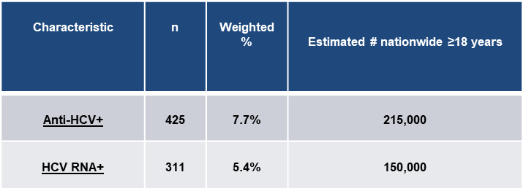

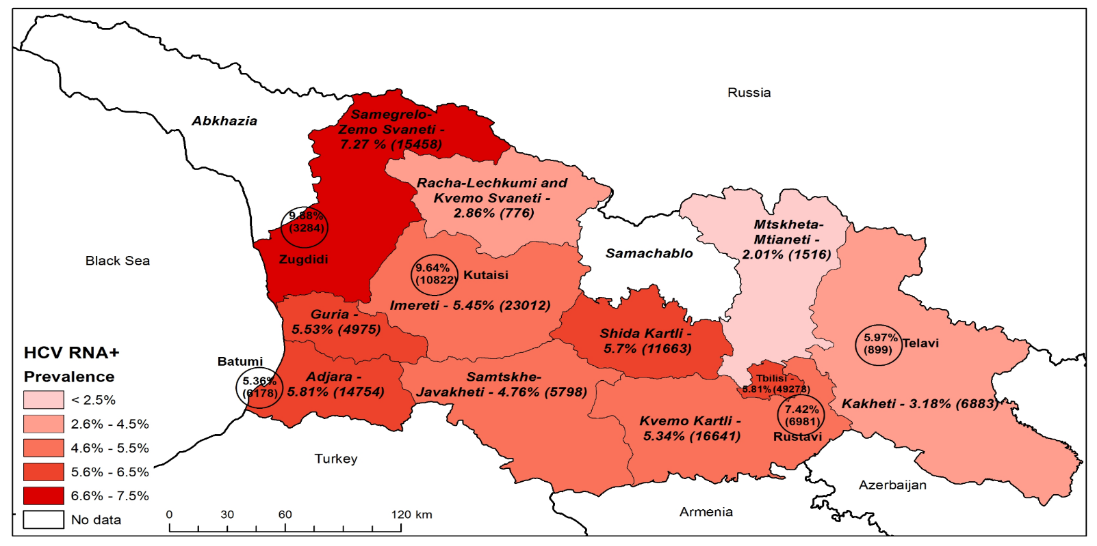
HCV Seroprevalence Survey, 2015

Slide 3

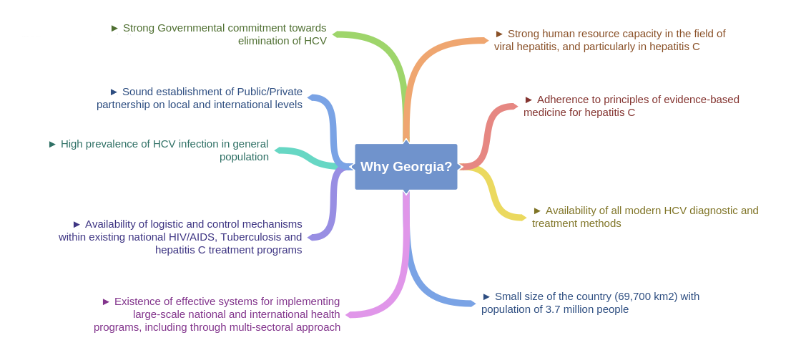
Georgian HCV Elimination Program – Best Example of Universality

Slide 4


Road Towards HCV Elimination
45.5% (1,3 million) of adult population is screened for HCV
53,393 people (41.6% of the target) are enrolled in treatment
Patient inclusion criteria removed
Long-term Elimination
Strategy 2016-2020 approved
Geographic and financial access to
diagnostic services - significantly increased
2016
2018
LDV/SOF based regimens
introduced to the program
Moving from vertical to horizontal service delivery systems through active engagement of PHC centers
TAG established
Decentralization of HCV services
Overall SVR rate 98%
Elimination through Decentralization
2nd World Hepatitis Summit
First Regional Consultation on Viral Hepatitis in the WHO European Region Held in Tbilisi
World Hepatitis Summit
Enhancement of electronic information systems
6th National HCV Workshop in March
Memorandum of Understanding between Georgian Government and Gilead Sciences
2015
Expansion of HCV service decentralization
2019
HCV Screening Protocol approved by the Ministry
2017
New Medication Vosevi (SOF/VEL/VOX) to be introduced
Initial phase of HCV elimination action plan and start of the program
TAG recommendation on decentralization
Initiating integrated screening on the
whole country level

Slide 5

National HCV Elimination Strategy
Goal
Elimination of HCV by ensuring prevention, diagnostics and treatment of the disease
Promote advocacy, awareness and education, and partnerships for HCV associated resource mobilization
Prevent HCV transmission
Identify persons infected with HCV
Improve HCV laboratory diagnostics
Improve HCV Surveillance
Provide HCV care and treatment
Targets
90-95-95
By 2020
90% of people living with HCV are diagnosed (n=135,000)
95% of those diagnosed are treated (n=128,250)
95% of those treated are cured (n=122,000)

Slide 6
The screening groups
Anti-HCV Screening
Mandatory for service providers
Optional for service providers
Integrated Screening (HCV/HIV/TB)
in Primary Healthcare Services
Pregnant women
Blood donors
Hospitalized patients
Recruits
High risk groups
Prisoners
General Population, Ambulatory Patients,
Chronic Patients
The state program of "Maternal and child health"
Blood banks
Licensed hospitals
Ministry of Defense
Global Fund's Project, the state programs for treating HIV / AIDS and Tuberculosis
The state program of Hepatitis C Management

Slide 7
HCV Screening Among the Georgian Population
Since 2015, over 2,5 million screenings have been registered in the Unified Screening Registry
≈1,56 million individuals (1,36 mill.adults) have been screened with a positivity rate of 8.15%

Slide 8



Number of HCV testing sessions among PWIDs by years
14 Harm Reduction Centers
6 Mobile Units
>80 Harm Reduction Workers
Negative
Positive
% of AB Positive
Source: GHRN Data
www.NCDC.ge

Slide 9
Micro-elimination in Specific Risk-Groups
 | TB Patients | HIV Infected Individuals | Hemophilia Patients | OST Program Beneficiaries | Dialysis Patients | War Veterans and Their Family Members
Target Population | 3,276 | 4,126 | 383 | 9,614 | 3,017 | 69,255
Screenings | 2,359 | 3,588 | 164 | 7,436 | 2,510 | 27,308
Screening Coverage % | 72.01% | 86.96% | 42.82% | 77.35% | 83.20% | 39.43%
Of Those Positive | 471 | 1,410 | 88 | 6535 | 554 | 3,577
Finding Screening Positives % | 19.97% | 39.30% | 53.66% | 87.88% | 22.07% | 13.10%

Slide 10


Concept: Three Diseases (HIV/HCV/TB) Under One Umbrella
Pilot project in Samegrelo-Zemo Svaneti region was launched in November, 2017
Integrated HCV/HIV/TB screening protocol approved - Target for screening - 40% of local population
454 doctors and nurses trained
Integrated multidisciplinary service monitoring groups established
Municipal programs supporting pilot implementation approved
In 8 months 89,602 persons were screened on HCV, HIV and TB among which
Anti-HCV+ 2350 cases
Anti-HIV+ 37 cases
Presumptive TB 177 cases
Following the Samegrelo-Zemo Svaneti example, a similar project has been initiated in the Adjara region
Guria, Racha-Lechkhumi and Kvemo Svaneti, Kutaisi, Kharagauli will be introduced to the program next
Kharagauli

Slide 11
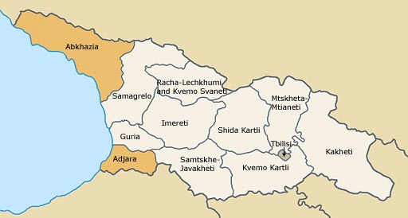
Treatment Providers
2015 - 4 sites
2018 - 42 sites
2019 - 70 sites in the decentralization process

Slide 12
Hepatitis C Elimination Program Care Cascade
29,928 Anti-HCV+ individuals did not get a confirmatory test
98.4%
74.6%
85.2%
80.7%
14,617 HCV RNA+ individuals did not initiate treatment
99.6%
99.9%
97.8%
93.4%
79.1%
98.2%
Treatment Coverage is 41%
*Among persons with PID. Does not include persons with 15-digit code

Slide 13
Enrollment in the HCV Treatment Program
LDV/SOF introduced
SOF introduced
Decentralization
SOF/VEL introduced
SOF/VEL/VOX to be introduced

Slide 14
Future Plans
Strengthen Follow-up and Linkage to Care
Strengthen the Involvement of the Primary Healthcare Sector
Implement the Samegrelo-Zemo Svaneti Project Countrywide
Intensify Enrollment of the Harm Reduction Network
Strengthen Communication campaigns
Intensify Routine Screening
79,819 adults were Diagnosed HCV RNA+ by Screening
14,617 HCV RNA+ individuals have not initiated treatment
40.47% of cases are left to find
1,301,749 adults have been screened
1,557,813 adults are left to screen

Slide 15
Conclusion
HCV Elimination program is a major driver for Health System Strengthening and advancing Public Health Agenda in Georgia, especially for HIV and TB. HCV elimination program supports the development of other key public health programs such as Safe Blood, Infection Control, Harm Reduction, etc.
In almost 4 years of the HCV Elimination Program, Georgia has scaled up the screening and treatment services achieving impressive results - 41% treatment coverage with 98.2% cure rate
Enhancing HCV testing and linkage to care and treatment services are critical to reaching the 2020 HCV elimination goals
Provision of HCV screening, confirmation, care and treatment services at non-specialized settings nearer to patients’ homes is critical for achieving the elimination goals
Decentralization and integration of HCV/HIV/TB services’ delivery in primary care or harm reduction settings can result in overcoming barriers to access care and treatment
Lessons learned from the Georgia elimination program can inform programs in other countries striving to eliminate HCV as a public health threat.

Slide 16









Acknowledgements
HCV Elimination Program Providers
TAG Members

